Slide 1


MOVIE MANAGEMENT SYSTEM
PREPARED BY :VIRTI PRATIKKUMAR SHAH
ROLL NO:2
ENROLLMENT NO:21002170110208
BATCH:S1
BRANCH:CE

Slide 2
INTRODUCTION
This project is aimed to provide the customers facility to book tickets for theatres online, through which they can book tickets anytime, anywhere.
E-ticket system is basically made for providing the customer an anytime and anywhere service for booking the seat in the theatre and to gather information about the movies online. The user can easily be able to know about the movies released and then make the choice.
Admin can manage information of movies.

Slide 3
ABOUT THE DATABASE
So, in this project important tables of the database are theatre, movie, movie booking , seat category , etc.
In this tables information are like name, show timing , date of booking, date watch, total amount, total tickets, etc.
Also some mapping tables has been created to establish the relation between the tables like for example a mapping table is been created to have a relation between theatre and screen
And also some procedures is been created to add, search, update, delete, book movie and triggers are been created so as to remark changes in table.
Also created few views like of movie & show timing, theatre & screens,

Slide 4
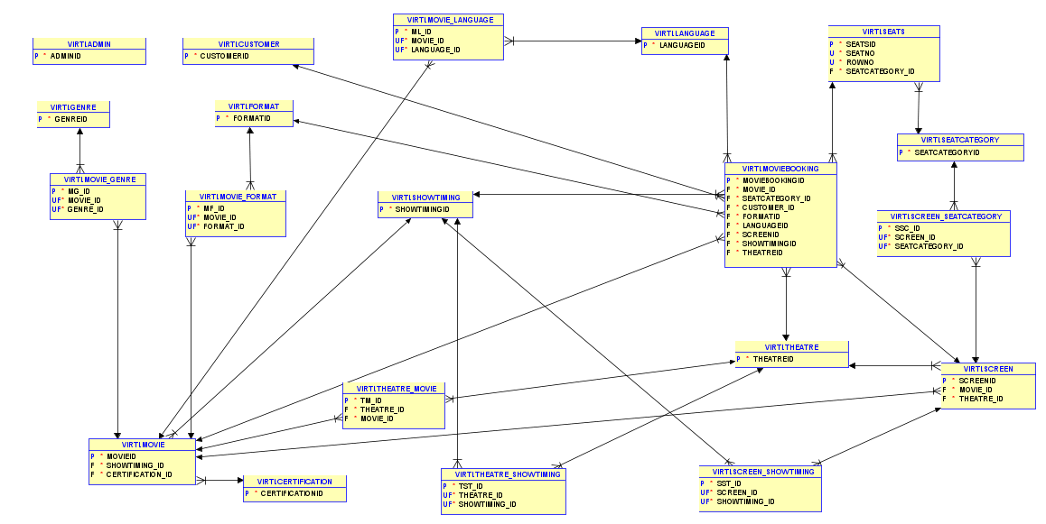
CLASS DIAGRAM

Slide 5
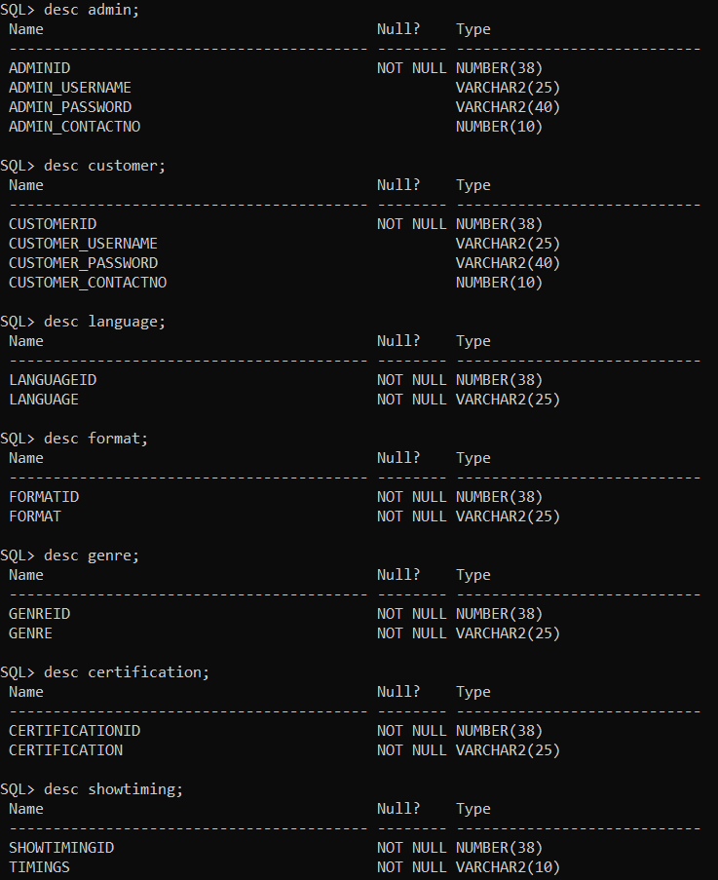
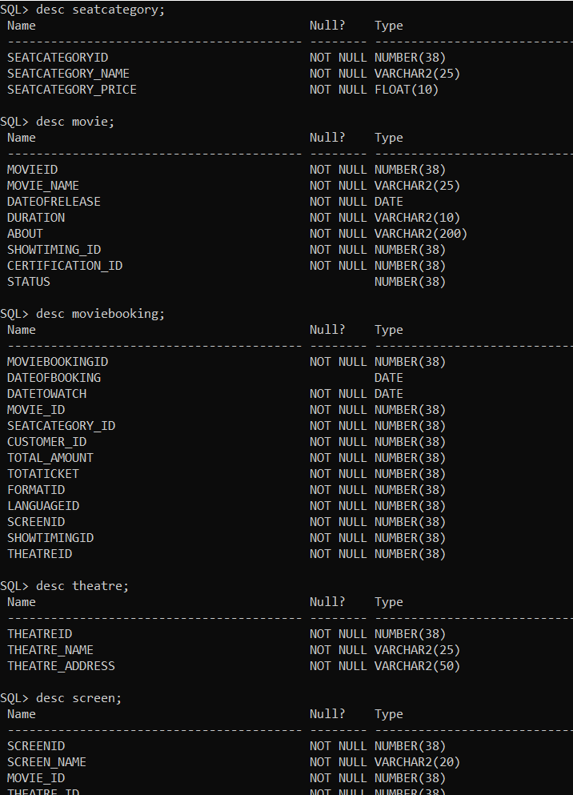
TABLES OF THE DATABASE

Slide 6
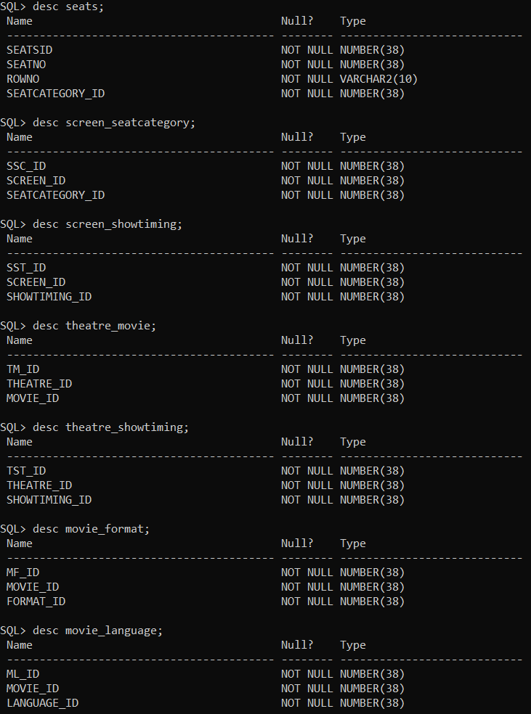
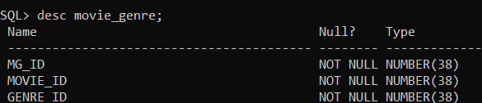
TABLES OF THE DATABASE

Slide 7
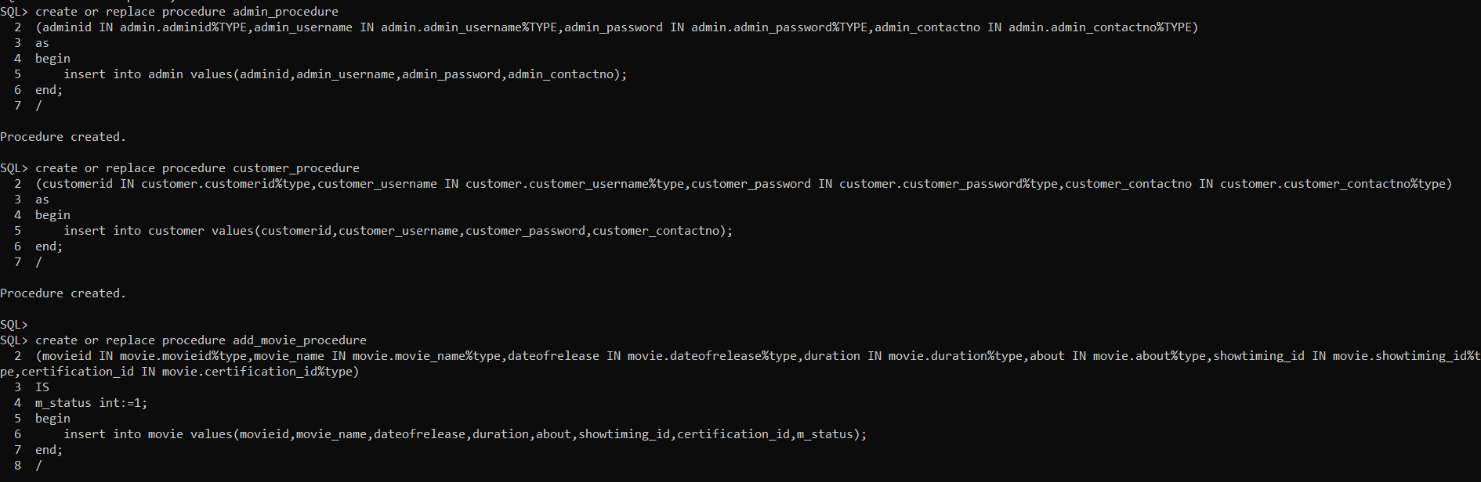
PROCEDURES

Slide 8
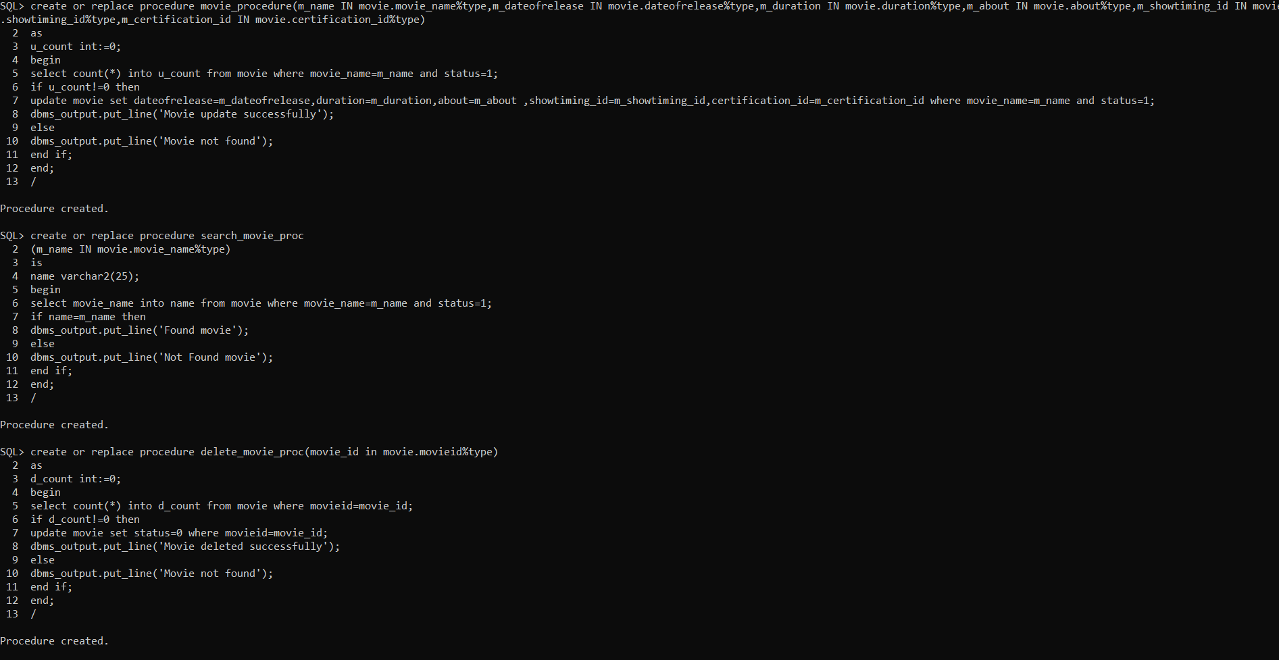
PROCEDURES

Slide 9
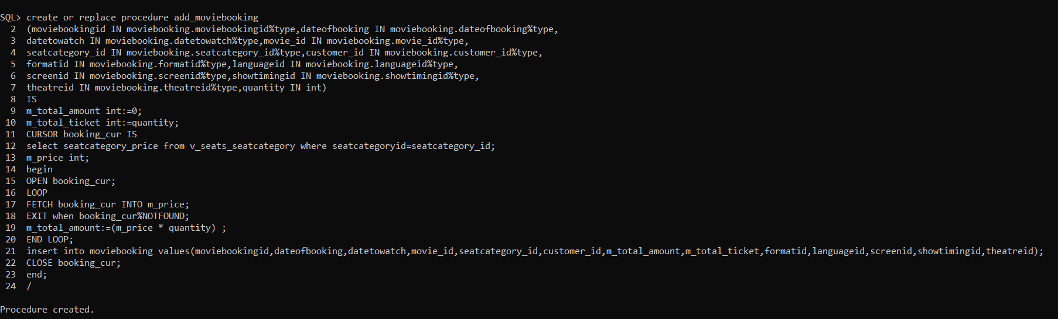
PROCEDURES

Slide 10
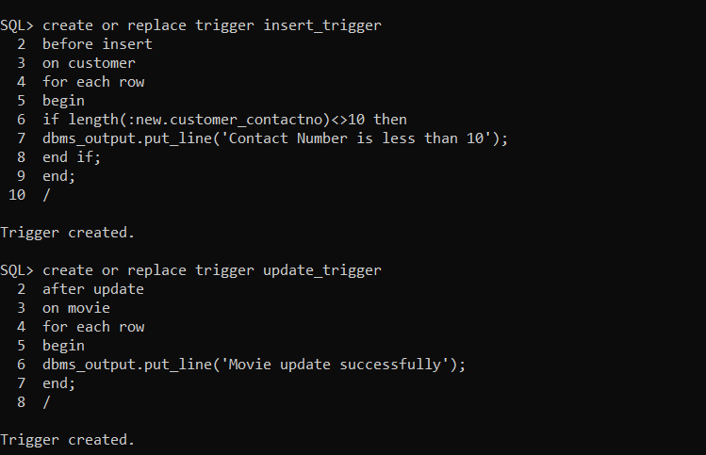
TRIGGERS

Slide 11
THANK YOU

